Slide 1
Media Messages on Stalking
This project was supported by Grant No. 2017-TA-AX-K074 awarded by the U.S. Department of Justice, Office on Violence Against Women (OVW). The opinions, findings, conclusions, and recommendations expressed in this program are those of the authors and do not necessarily reflect the views of OVW.
Notes:
As a society, we aren’t taught very much about stalking.
We mostly learn about stalking through how it’s presented in media.

Slide 2
The media does not cause stalking. Stalkers cause stalking.
Notes:
It’s essential to recognize that the media does not cause stalking.
Casually using the term “stalking” does not cause stalking.
Many people are exposed to the same media and language and do not choose to stalk.
Only perpetrators are responsible for their behavior.

Slide 3
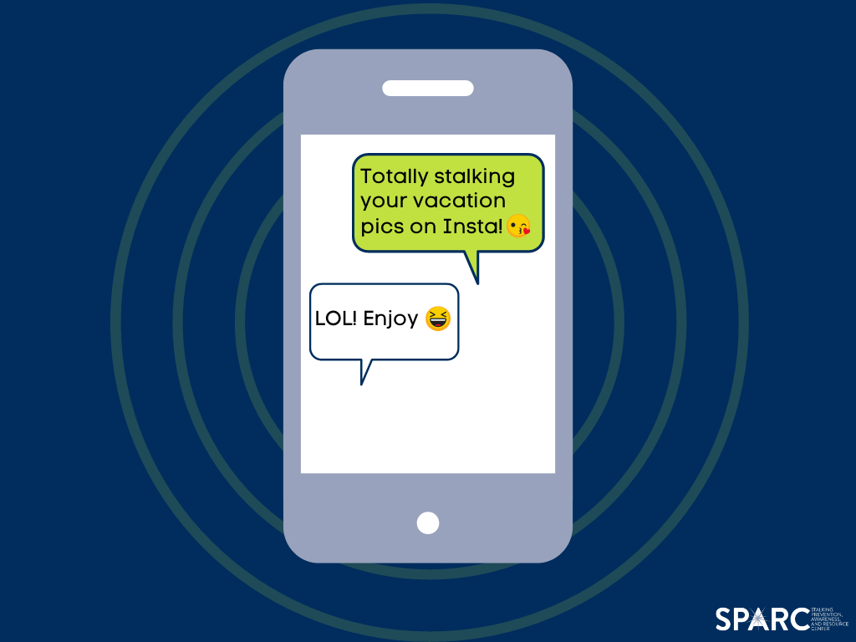
Facebook Stalking
“I was totally Facebook stalking you and I saw you went to Mexico – it looked awesome!”
Is this stalking? Why or why not?
Notes:
You may have heard people use the word “stalking” casually in conversation, especially about their use of social media.
Consider this example --
Let’s say you receive a text message like the one on the screen from a friend.
Is this stalking? Why or why not?
Based on the information we have, assuming these people know each other, this is not stalking because it is not scary for a friend to look at pictures that you posted on social media.
Why does it matter that the term “stalking” is used casually?
It dilutes the meaning of the word.
Stalking is underreported and misunderstood.

Slide 4
Notes:
What stalking behaviors have you seen in media that would be scary if they happened in real life? Think about TV, movies, music, social media, books, and more.
Grand gestures that we often see presented as romantic in media are often scary in real life.
Popular love stories often include elements of obsession.
Many romantic films feature male protagonists who will “stop at nothing” to “get the girl,” pushing past her rejection until she accepts and loves him.

Slide 5
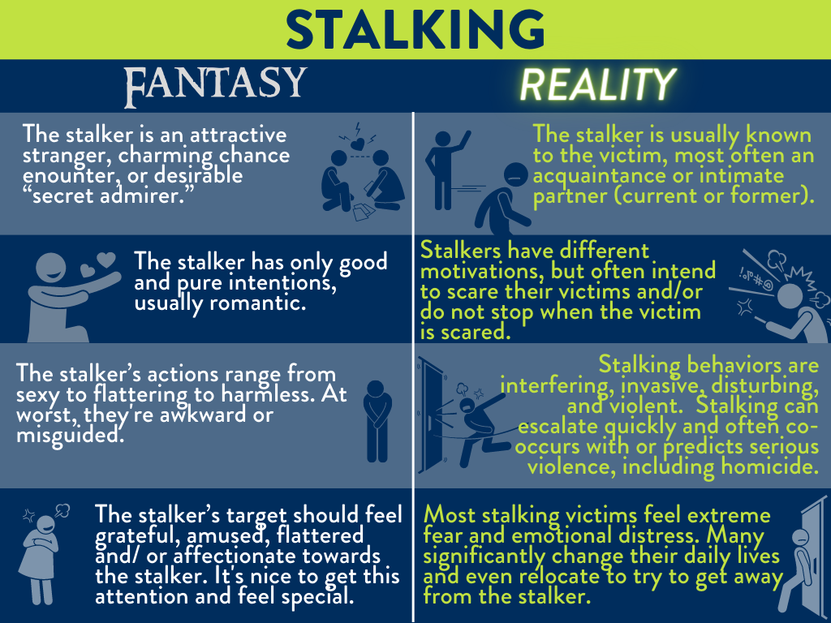
The Fantasy | The Reality
The stalker is an attractive stranger or “secret admirer.” | The stalker is usually known to the victim and is most often a current or former intimate partner.
The stalker has only good and pure intentions, usually romantic. | Stalkers have different motivations, but often intend to scare their victims and/or do not stop when the victim is scared.
The stalker’s actions range from sexy to flattering to harmless. | Stalking can escalate quickly and often co-occurs with or predicts serious violence.
The stalker’s target should feel amused, flattered and/or affectionate towards the stalker. | Many stalking victims report feeling extreme fear and emotional distress.
Notes:
Stalking in media often creates a fantasy of stalking that is different than the reality.
Stalkers are often presented as attractive strangers or secret admirers with good intentions.
In reality, stalkers are usually known to the victim, intend to cause fear and are likely to become threatening and/or violent.

Slide 6
Notes:
In addition to being shown as romantic, is also often shown as funny, heroic, and/or edgy.
Funny: there is a trope of a character not understanding boundaries and showing up again and again (like Spongebob and Squidward’s relationship)
This media doesn’t show any real negative consequences for the stalking, it’s “played for laughs” and no one is harmed.
Heroic: Superhero movies often feature an isolated hero watching over the city so they can swoop in and save their loved ones and friends.
Stalkers may say things like “I trust you, I don’t trust the people around you” to justify constant surveillance, casting themselves in a heroic role.
Edgy: Thrillers and horror movies may show stalking as scary (which is accurate), but also sensationalize it as “edgy” and/or “sexy” in its forbidden nature.
In reality, stalking is a prevalent victimization that many people actually experience – not an edgy escape.

Slide 7
Impacts of Media Normalization
Builds empathy with stalkers rather than victims.
Leads victims to minimize experiences.
Leads potential supports/friends of victims to dismiss experiences.
Misinforms general public about dangers and realities of stalking.
Creates an environment where stalkers can get away with stalking.
Notes:
Again, the media does not cause stalking.
However, the messages that media sends can create a warped landscape in which stalking is minimized, normalized, accepted and/or laughed off.
A lot of media on stalking is from the stalker’s perspective and shows hopeless romantics with good intentions.
This builds empathy with the perpetrator and may lead us to make excuses for stalkers and/or assume the best about them
Instead, we should be focusing on how victims feel about stalking and empathizing with them.
Victims may minimize or dismiss their experiences instead of taking early warning signs seriously.
Friends and potential supports – including law enforcement and service providers -- may underreact to a victim’s concerns, treating stalking as “awkward” or “romantic”

Slide 8
www.StalkingAwareness.org
Training modules
Victim resources
Practitioner guides
Webinars
@followuslegally
This project was supported by Grant No. 2017-TA-AX-K074 awarded by the U.S. Department of Justice, Office on Violence Against Women (OVW). The opinions, findings, conclusions, and recommendations expressed in this program are those of the authors and do not necessarily reflect the views of OVW.
Notes:
For more information on the crime of stalking, visit SPARC at www.StalkingAwareness.org
SPARC does NOT provide direct services to victims.

