Slide 1
Understanding Stalking
This project was supported by Grant No. 2017-TA-AX-K074 awarded by the U.S. Department of Justice, Office on Violence Against Women (OVW). The opinions, findings, conclusions, and recommendations expressed in this program are those of the authors and do not necessarily reflect the views of OVW.
Notes:
Welcome.
My name is [name] and I’m [role].
This training was created/contributed to by the Stalking Prevention, Awareness and Resource Center (SPARC)– the only technical assistance provider on stalking.

Slide 2
Behavioral Definition
Stalking is a pattern of behavior directed at a specific person that would cause a reasonable person to feel fear.
Notes:
Stalking is a crime in all 50 states, US territories, tribal lands and the District of Columbia.
Different states have different definitions of stalking.
A good behavioral definition is a pattern of behavior directed at a specific person that would cause a reasonable person to feel fear.
Some of the important concepts here have been highlighted.
Stalking is a pattern of behavior that requires 2 or more behaviors.
Many different behaviors can be part of a stalking pattern.
Some stalking behaviors are criminal (for example, property damage).
Others are not crimes on their own (for example, sending gifts), but can become criminal when part of a stalking course of conduct.
Common stalking behaviors include (but are not limited to): calling or texting excessively, following, spreading rumors, surveillance and tracking.
Stalking is directed at a specific individual, not a group.
However, stalkers may target other people close to the primary victim – like family members or a new boyfriend or girlfriend.
Fear is key to the definition of stalking.
Fear is how we differentiate stalking from other crimes, like harassment.
Harassment generally describes behavior that is irritating, while stalking describes behaviors that cause fear.

Slide 3
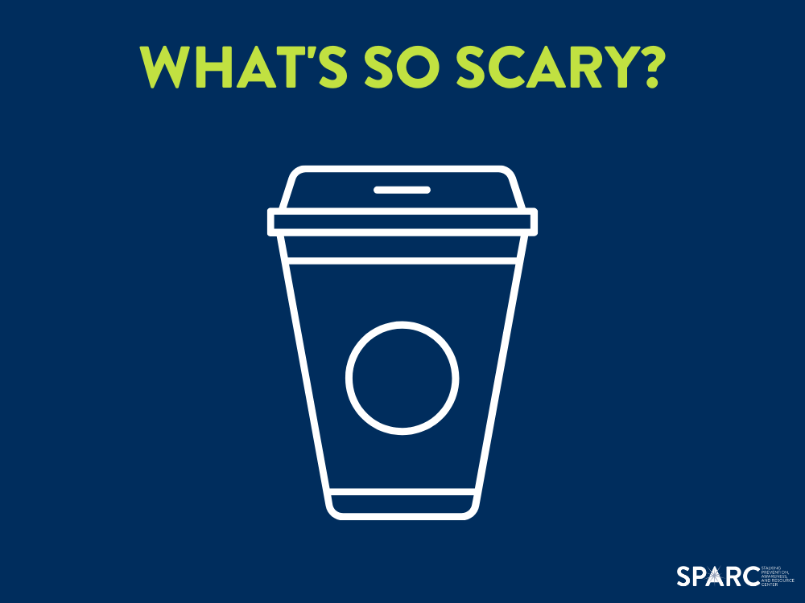
What’s so Scary?
Notes:
Context is critical in stalking cases.
Consider this story:
A woman calls the police, hysterical.
All she’ll say is “there’s a cup of coffee in my car.”
Understandably, the police don’t understand what the big deal is and don’t see the situation as urgent.
Eventually, she says “he’s here.”
It turns out this was a stalking victim who had moved to escape her abusive ex-boyfriend, who was stalking her.
She did not believe he know where she was.
When she left for work that morning, there was a coffee cup in her car with his old nickname for her on it.
She was terrified.

Slide 4
Context is Critical
Something may be frightening to the victim but not to you
Stalking behaviors often have specific meanings
Stalking criminalizes otherwise non-criminal behavior
Notes:
Context is critical to understanding stalking.
Something may be frightening to the victim but not to you as the responder.
Stalking behaviors often have specific meaning that may only be understood between offender and victim.
If the cause for fear is not intuitive, it’s essential to ask victims “Why did that scare you?”
Stalking criminalizes otherwise non-criminal behavior.
It’s not illegal to text someone or send a gift or to ring their doorbell – unless it’s part of a stalking course of conduct.

Slide 5
Stalking Behaviors
Baum, K., Catalano, S., Rand, M. (2009). Stalking Victimization in the United States. Washington, DC: Bureau of Justice Statistics. Retrieved from https://www.justice.gov/sites/default/files/ovw/legacy/2012/08/15/bjs-stalking-rpt.pdf.
Notes:
Stalkers engage in a variety of behaviors, both in-person and through technology.
Some of the most common behaviors are making unwanted calls and messages, spreading rumors, following and spying.
Most stalkers use multiple strategies to scare their victims.

Slide 6
Notes:
Stalkers engage in a variety of behaviors, both in-person and through technology.
Some of the most common behaviors are making unwanted calls and messages, spreading rumors, following and spying.
Most stalkers use multiple strategies to scare their victims.

Slide 7
Prevalence in a Lifetime
More than 1 in 6
WOMEN
More than 1 in 17
MEN
Smith, S.G., Zhang, X., Basile, K.C., Merrick, M.T., Wang, J., Kresnow, M., & Chen, J. (2018). The National Intimate Partner and Sexual Violence Survey (NISVS): 2015 Data Brief. Atlanta, GA: National Center for Injury Prevention and Control, Centers for Disease Control and Prevention.
Notes:
1 in 3 women and 1 in 6 men in the U.S. will experience stalking in their lifetime.

Slide 8
Victim and Offender Relationships
Notes:
The vast majority of the time, victims know their perpetrators.
The majority of stalkers are intimate partners (current or former) or acquaintances.
Stalking can be a method of exerting power and control in an abusive relationship.
It is also essential to realize that many stalkers are NOT intimate partners.
Particularly for male victims, the stalker is often an acquaintance.

Slide 9
Stalking Can be Dangerous
Over 1 in 5 stalking cases involve a direct attack on the victim.
Over 1 in 5 stalkers use a weapon to threaten or harm their victims.
76% of femicide victims were stalked before being murdered.
Baum, K., Catalano, S., Rand, M. (2009). Stalking Victimization in the United States. Washington, DC: Bureau of Justice Statistics. Retrieved from https://www.justice.gov/sites/default/files/ovw/legacy/2012/08/15/bjs-stalking-rpt.pdf.
McFarlane, J., Campbell, J.C., Wilt, S., Ulrich, Y., & Xu, X. (1999.) Stalking and Intimate Partner Femicide. Homicide Studies 3 (4), 300-316. Retrieved from http://ncdsv.org/images/HomicideStudies_StalkingAndIntimatePartnerFemicide_11-1999.pdf.
Notes:
Stalking can be a major predictor of violence and even murder.
Many stalkers directly attack their victims.

Slide 10
Resources for Help
Victim Connect www.VictimConnect.org
Local Resources [fill in here]
Notes:
Note: Add in local resources that can be shared

Slide 11
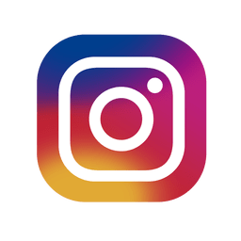
www.StalkingAwareness.org
Training modules
Victim resources
Practitioner guides
Webinars
@followuslegally
This project was supported by Grant No. 2017-TA-AX-K074 awarded by the U.S. Department of Justice, Office on Violence Against Women (OVW). The opinions, findings, conclusions, and recommendations expressed in this program are those of the authors and do not necessarily reflect the views of OVW.
Notes:
For more information on the crime of stalking, visit SPARC at www.StalkingAwareness.org.
SPARC does NOT provide direct services to victims.

